Slide 1
Working with complex data
IN721 2017
Design and Development for Mobile Devices
Session 7.2
Notes:
So far in our Android development, we have used a variety of Android classes, like Activities and TextViews and Fragments and Adapters and LayoutInflaters, and so on.
Our data, however, has only been scalar. That is, we have used only strings, or integers or booleans.
However, the Android libraries are just java and when working with them, we therefore have all the power of java to play with, including the ability to declare and use our own classes.
Today we will look at how to use complex data in Android, and in particular at how to cope with the specific situation where we want to display complex data in one of the Android collection controls (i.e. spinner, ListView, etc.)
Let’s start with a brief look back at the ListView…

Slide 2
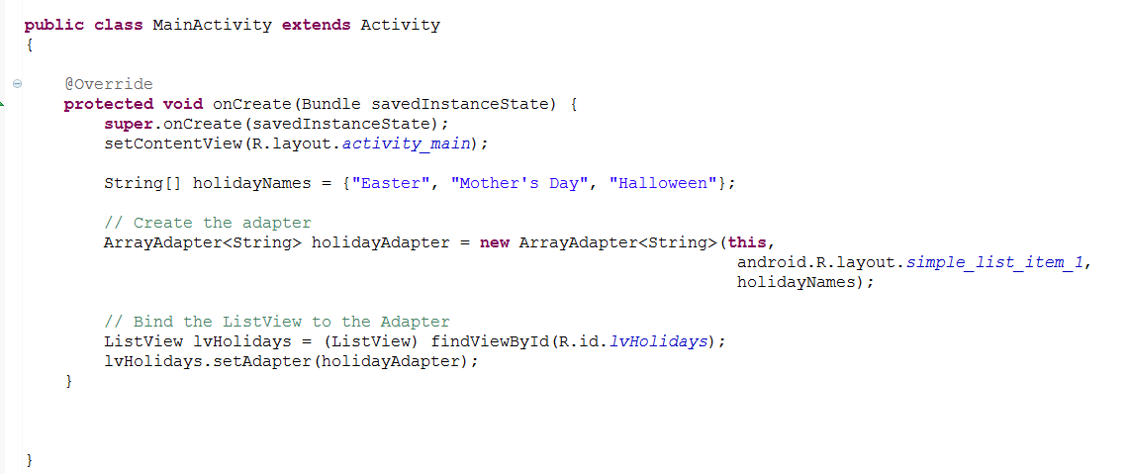
Basic ListView
Notes:
Here is the very familiar loading up of an array of string into a ListView using an Adapter and one of the built-in layouts.
When you run the app, it looks like....

Slide 3
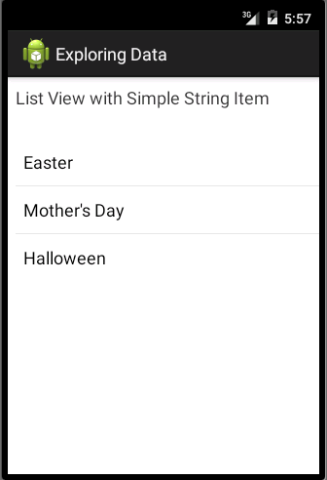
Basic ListView
Notes:
What if we wanted to store more information about our holidays, however?
Perhaps we are building some sort of calendar program and we need to know the exact dates, as well as the holiday name.
We know that, in OO, when we want to bundle multiple pieces of data together, we implement a class.
Let’s make a nice Java class for ourselves...

Slide 4
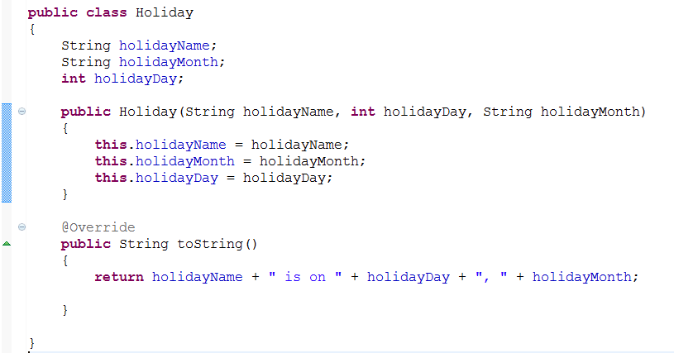
The Holiday Class
Notes:
For simplicity in this example, we are going to store month as string and day as int, but we could also use the Java date-time classes if we had the energy.
We have this simple class with three data fields.
We need to define how it should “print itself”, so we override toString().
What if we now want a list of these?
We still need an array, but it will be an array of Holiday objects.
If we try to shove that array into our adapter, we run into trouble...

Slide 5
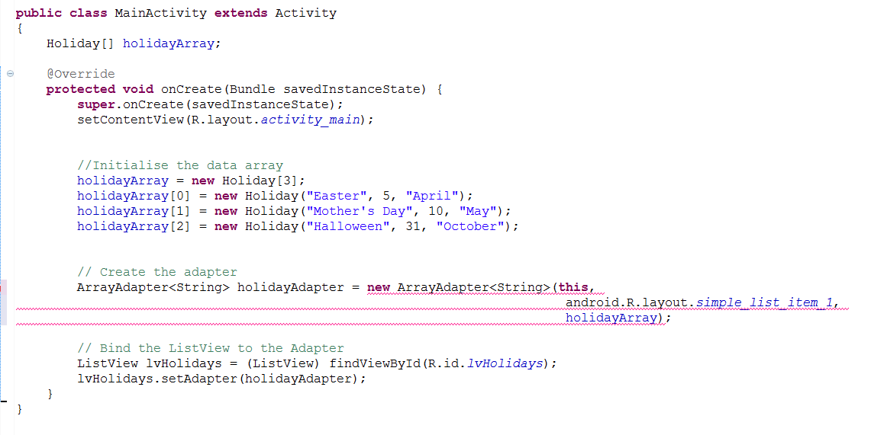
The Holiday Class
Notes:
Here we declare and initialise our array, and pass it in as the third argument to the adapter.
The compiler becomes enraged.
The problem is that we have asked for an ArrayAdapter<String>. That constructor wants an array String, not an array of Holiday.
That argument in the <> actually means “the type of data items we want you to stuff into the ListView”
Fortunately, this is easy to fix. We can just ask for an ArrayAdapter<Holiday>.

Slide 6
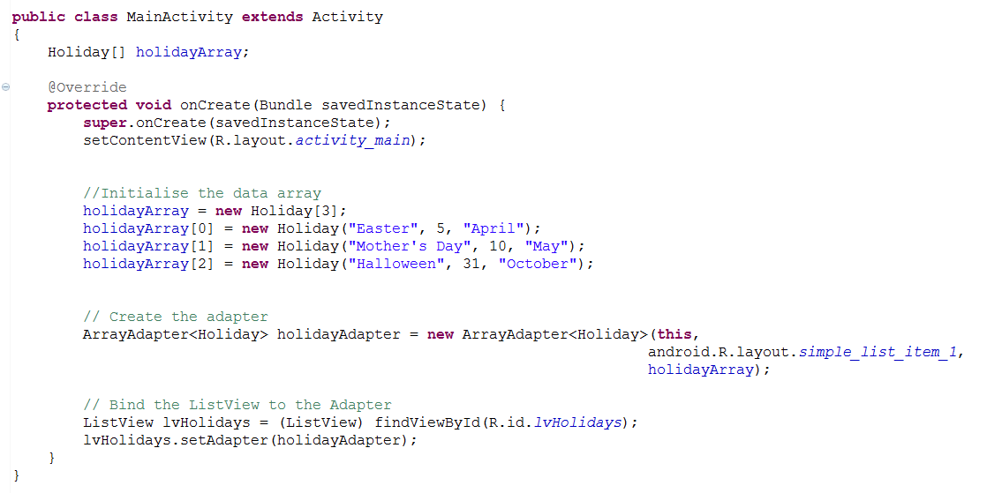
The Holiday Class
Notes:
...our code is happy.
The app runs like this...

Slide 7
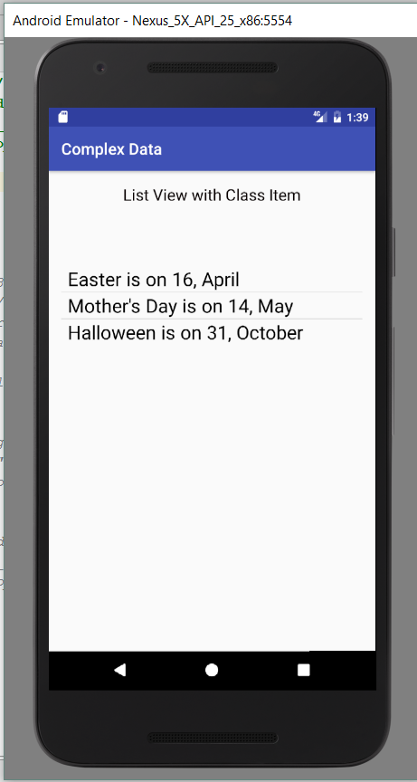
The Holiday Class
Notes:
Let’s look at this carefully.
We passed in an array of Holiday instances. But what did the adapter actually put into the list? => the output of the toString method for each instance.
We can confirm this.
Let’s go back into our Holiday class and comment out the toString

Slide 8
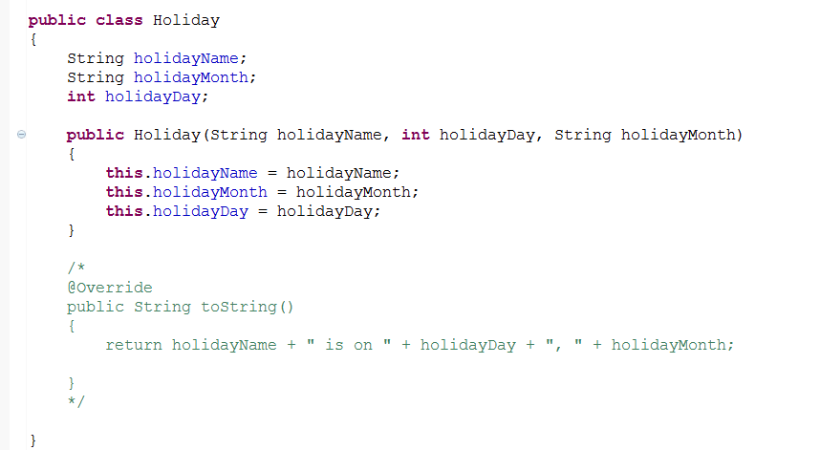
The Holiday Class
Notes:
.. And now we run the app..

Slide 9
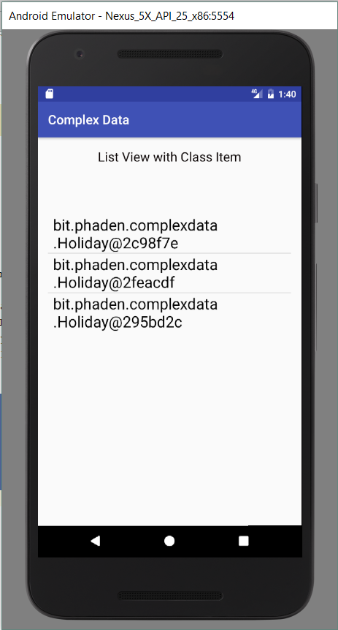
The Holiday Class
Notes:
This is what the system’s toString returns when called on a complex class that doesn’t provide a ToString() method override.
The data type and id of the instance.
So clearly, the ArrayAdapter<x> puts the toString of the object into the ListView.
It calls ToString, assigns the result to the Text property of the TextView layout that we passed in, inflates it, and uses that to build the list.
That’s fine, as long as our class is something that can be sensibly represented with a single string output.
But what if it can’t?
What if, for example, we want to add an adorable little image to our holiday class, and have that appear in the list item.
We can extend the class like this...

Slide 10
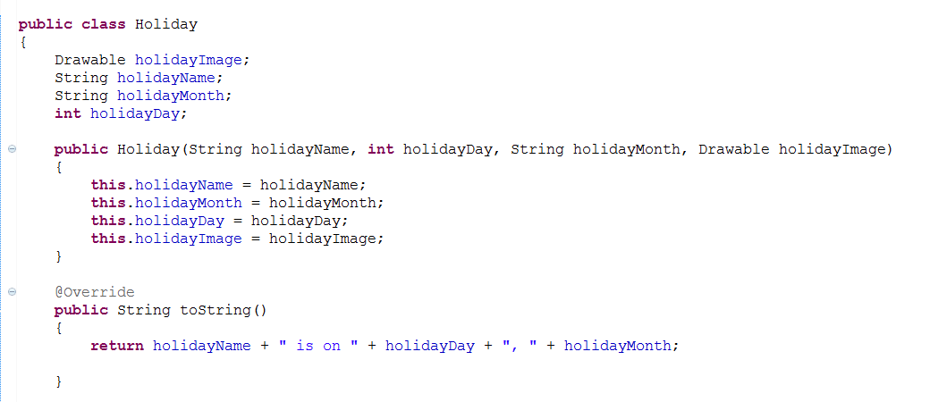
The Improved Holiday Class
Notes:
...and we can certainly create an array of instances.
It’s a little more complex, because we need to get those images in there, but we know how to do that...
Because the code is getting a little long, I don’t want to dump it inline into the onCreate, so we’ll pop it into a little method still in MainActivity, like this...

Slide 11
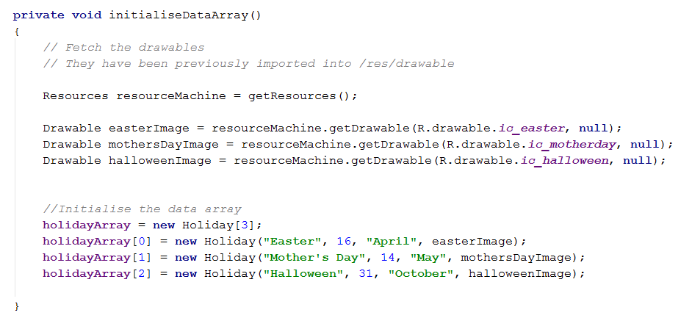
In MainActivity...
Notes:
NB: getDrawable was changed in API 21. This is the new version. The second argument is a theme ID; we are choosing not to specify a theme (we don’t want theme formatting for these images). If you use this version, you will need to change your min SDK to 21 (do this in build.gradle (Module:app)). The older, deprecated version of getDrawable has just one argument – the image resource ID. If you use that version, your code will still run fine, but the method call will be struck-through. Either approach is fine for this practical.
...but now we have a problem.
We have to get that adapter set up.
We know that, if we just leave it like it is, it will call the toString method and we won’t see the image.
We noted before that the adapter calls toString, assigns the result to the Text property of the TextView layout that we passed in, inflates it, and uses that to build the list.
So clearly, if we want to see the image, we are going to need to get a layout into the adapter that contains the image.
Let’s try that.
Here’s a layout that will work...

Slide 12
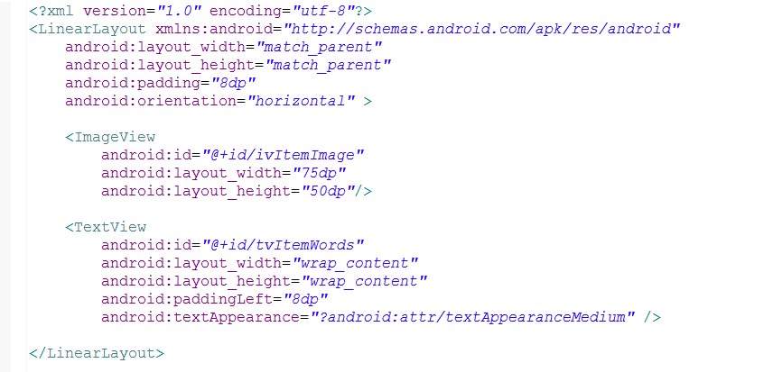
custom_listview_item.xml
Notes:
A linear layout with an ImageView and a TextView
Let’s try using that in the AdapterView

Slide 13
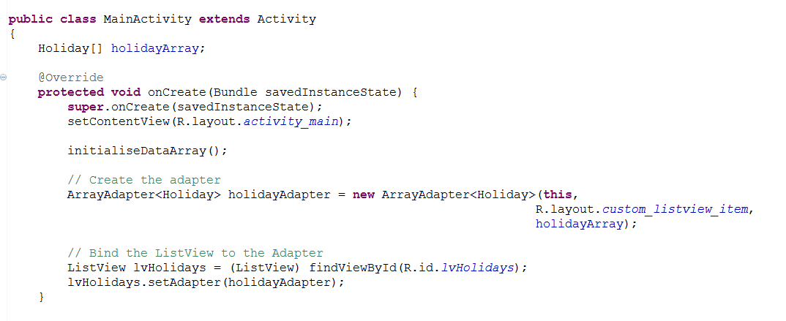
Changing the Adapter
Notes:
Here we have passed in the custom_list_view
Note that we also called initialiseDataArray to make the holidays and put them in holidayArray.
If we run this now, does the system put the holiday in the new layout, inflate it and pass it to the list?
Let’s see...

Slide 14
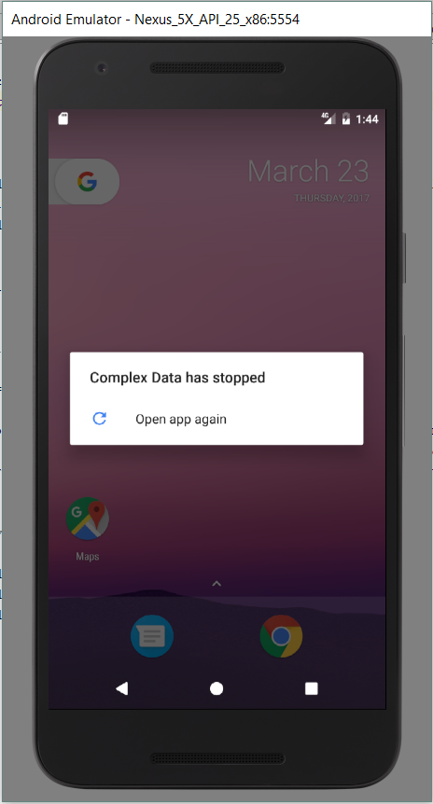
Changing the Adapter
Notes:
Sadly, no.
Let’s go to logcat and see what the error was...

Slide 15
Changing the Adapter
Notes:
There it is.
ArrayAdapter requires a simple textview layout.
It ToStrings each item and loads that textview.
It won’t take a more complex layout.
We want to use a more complex layout.
So, we’re stuck. Sort of.

Slide 16
Extending ArrayAdapter
The basic ArrayAdapter only works with a single TextView.
To populate a ListView with something more complex, you must create a new class that extends ArrayAdapter.
Because our custom adapter class will be a worker for this Activity, we will declare it as an inner class of the Activity.
Notes:
That is, you must declare a new ArrayAdapter descendent that can deal with your more complex layout.
You can also make it work as a separate class, but the communication is a little more complicated, so we’ll do it this way.

Slide 17
How ArrayAdapters Work
When using an ArrayAdapter to fill a ListView, the system makes repeated calls to the Adapter’s getView method.
It calls getView for each element in the array, in order from first to last element.
The getView method returns a View loaded up from the corresponding element of its input array.
This View is put into position in the ListView.
To make our custom ArrayAdapter, we will override the getView method.
Notes:
Before we can extend the ArrayAdapter base class, we need to understand how it works.
Most critically, we need to know which of its method(s) we will need to override to get the more complex behaviour that we want.
This is how ArrayAdaptors work…
The base class’s getView can only return TextViews. We are going to override it and make it return our fancy layout with its ImageView and TextView.

Slide 18
Overriding getView
public View getView(int position, View convertView, ViewGroup container)
Get a LayoutInflater (luckily, our containing Activity can make one for us).
Inflate a view from our custom layout.
Grab references to the controls in the inflated layout (i.e. the View).
Get an item from the input array. (Adapters have a method for this.)
Fill the controls of the View with the information from the array.
Return the View.
Notes:
Here is the method. Note container and position. We are going to use them later.
NB: If you autofill this method, the ViewGroup will be called parent, but it makes no difference
Here, in pseudocode, is our plan
Our Activity can make an inflater, and we will be able to talk to our Activity because we are an inner class
Remember our custom layout? It had an ImageView and a TextView?
Use findViewById for this. We will again borrow the inflated View’s findviewById method
Remember the array of holidays is passed into the Adapter constructor? We will use the Adpater’s getItem method to pull out the current holiday. How will we know which one we are on? ➔ Look at that “int position” parameter up there…
Normal set method stuff
Normal return.
Let’s look at each step, then put it all together…

Slide 19
Overriding getView
Get an inflater (luckily, our containing Activity can make one for us)
Notes:
Why is the syntax different?
Why can’t we just say getLayoutInflater? We could, if we were in the Activity itself, but here, in an inner class, we need one of our own.
I’m not sure why. Some technical problem having to do with threads, would be my guess.
So, we do it this way.

Slide 20
Overriding getView
Inflate a view from our custom layout
Notes:
This we know how to do…
The layout is the one we prepared earlier
The ViewGroup container argument is passed in to us, just like it is with onCreateView and fragments
The false parameter is also just something we do and don’t worry about.
Remember the name customView. We’re going to use his findViewById in the next step.

Slide 21
Overriding getView
Grab references to the controls
Notes:
This we definitely know how to do.
There’s customView helping us out
The resource Ids are the elements in our custom view

Slide 22
Overriding getView
Get the list item from the array. Adapters have a method for this
Notes:
getItem is an adapter method. Since we are extending Adapter, we can just call it.
Where does position come from? => If is passed in by the system.
When filling the ListView, the system calls getView with 0, then with 1, then with 2, and so on.

Slide 23
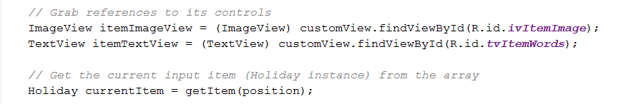

Overriding getView
Fill the controls of the view with the information from the array
Notes:
This we know how to do.
This one is a little easier to understand if you can see the lines of code that came right before it, so let’s look at it again with those added…

Slide 24

Overriding getView
Return the view
Notes:
And finally….
So you knew how to do pretty much everything except how to get the inflater and how to get the array item.
Now you know how to do those too.
Let’s look at the whole method…

Slide 25
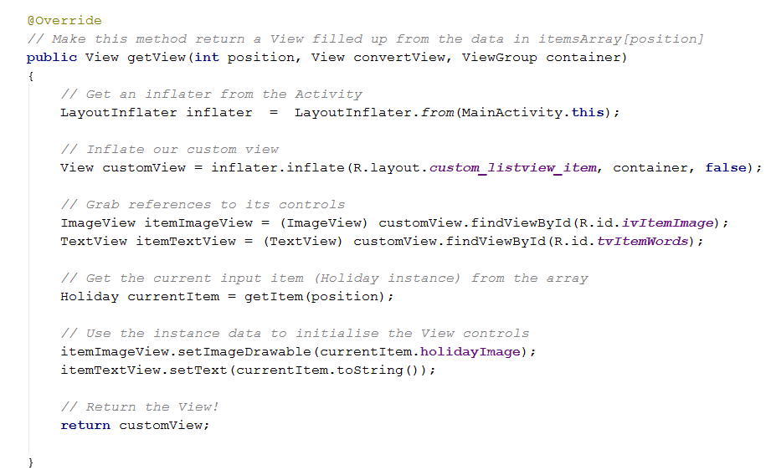
Overriding getView
Notes:
The whole thing...

Slide 26
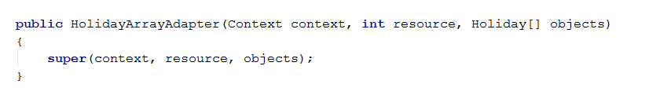
Just one more thing…
Our custom ArrayAdapter needs a constructor
Notes:
Remember, that method we wrote was an override in our custom class (it was a long time ago…check back if needed)
Now our new class needs its constructor
All we have to do is call the superclass constructor.
It looks like this for our HolidayArrayAdaptor
Experiment with the AS refactoring/code completion tools to see how to get help generating your child constructors
So here is our complete custom ArrayAdapter class…

Slide 27
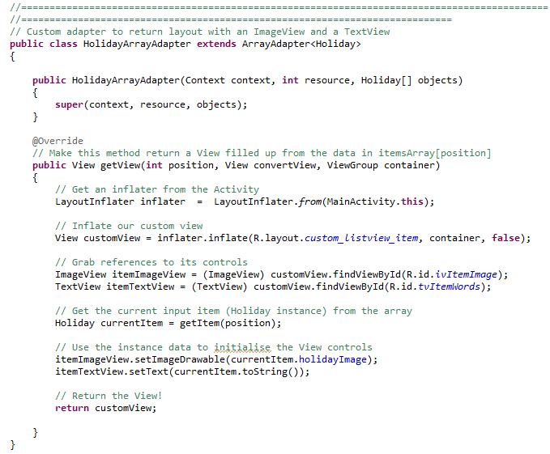
Custom ArrayAdapter
Notes:
Declared inside the Activity.
Class HolidayArrayAdapter
How do we use it?
Remember waaaaay back at the beginning when we made ArrayAdapter<Holiday>, and it only wanted to make TextView?
We go back there, and use one of these instead.

Slide 28

Using our Custom Class
Notes:
There it is.
He’s a descendent of ArrayAdapter, so he takes the same input arguments (that’s why we needed the constructor)
He’s not a template class, so he doesn’t have <xxxxx>.
Here is the complete onCreate method…

Slide 29
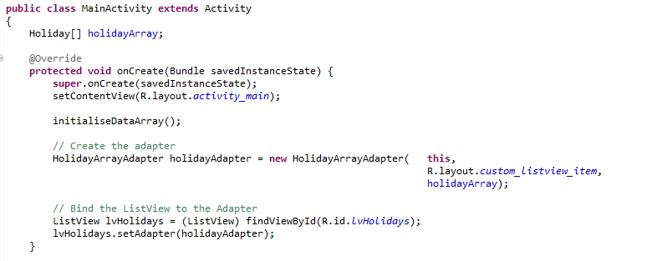
The Complete onCreate
Notes:
Showing also the class field Holiday[] holidayArray[], which we filled up in the initialiseDataArray method.
How does the app work?

Slide 30
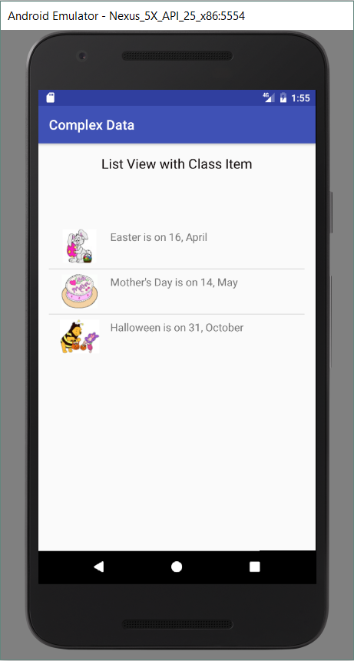
The App
Notes:
Adorable, right?
Why have we spent so much time on this, just to end up with an image in a ListView?
Because the process we went through is a big part of serious Android development.
The Android base classes are intended not only to provide their core functionality, but to provide a skeleton for extension when we want to add more functionality.
When you want to do something in Android, the process is often
1) find the class that does that basic version of the behaviour you want.
2) Figure out how it works. Focus on which methods you need to extend.
3) Descend from the class and override those methods.
4) Use your new class.
Because Android is open source, if you come up with something especially original and/or valuable, you might be able to add it to the code base, which would be super cool.

Slide 31
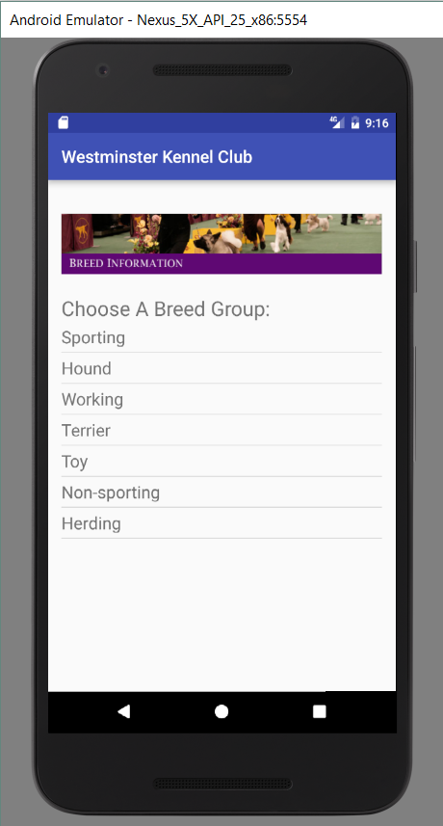
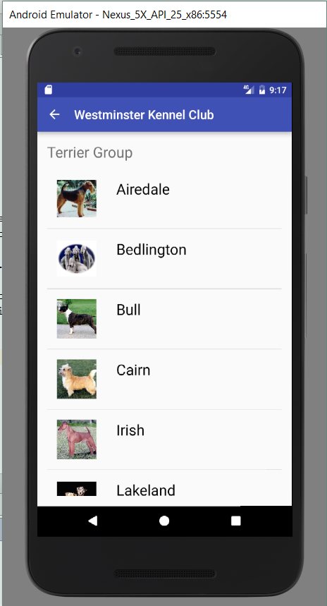
Practical: Part 1 (Required)
For one child only...
Notes:
Build an app that provides hierarchical navigation from a main list to a sub-list
On the sub-list, display for each item complex data containing at least an image and some text.
In this example, I have used the kennel club data; you can use whatever you want.
If you have done the “Welcome to Dunedin” app, you’ll have this partially built already, needing only to come up with, for example, a set of restuarants, but feel free to choose something else.
As indicated, you need do this for only one of the child lists.

Slide 32
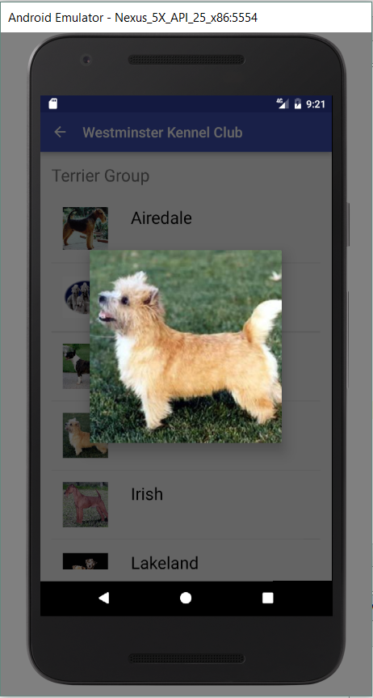
Practical Part 2 (Required)
New things:
setTag: Allows you to attach pieces of data to a View.
getTag: Allows you to fetch those pieces of data.
Creating a Bundle and adding data to it.
setArguments: Lets you attach a Bundle to a DialogFragment instance to make the Bundle available when onCreateDialog is raised.
Notes:
Extend your app so that when you click on one of the item images, it displays an enlarged version of the image as a dialog fragment.
NB: This is not easy. Plan to spend several hours at it. Don’t give up.
On the job, giving up isn’t an option.
While you know how to do (almost) all of the bits, handling the communication is not trivial.
Here are some things you will need to use that we haven’t covered in class....
setTag is sort of like being able to add data members on the fly
Finally time to break down and deal with bundles.
Creating is just a constructor call; adding data is much like intents – putThis and putThat...
You can just jump in and try this for yourself, and you’ll probably be able to figure it out. However, to provide a little momentum, you will find various code fragments from my solution at the end of this ppt. If you don’t want hints, don’t look.

Slide 33
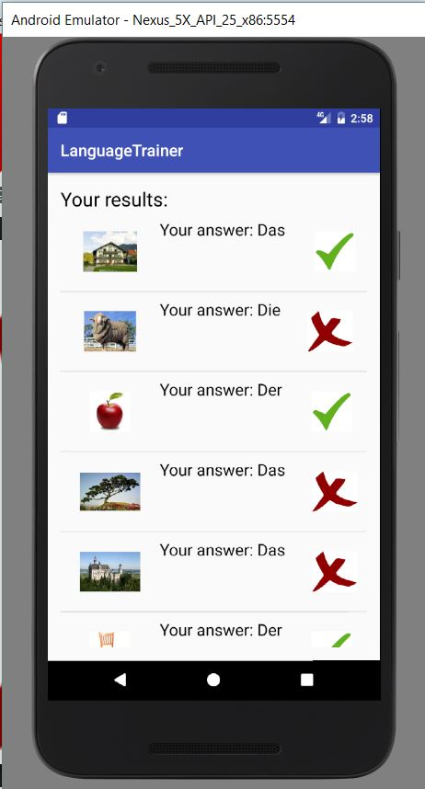
Practical Part 3 (Extra Credit)
Modify your Language Trainer so that the feedback screen shows a list of the results, with the original image, the user’s response, and accuracy feedback using an icon.
Notes:
If you get this running, it is worth two additional lab mark units.
You will need a listItem layout that holds two images and some te
You will probably want to pass complex objects from the main activity to the results activity (so you can store the word, the answer, etc.)
There are at least 3 ways to do this – two are “official” and one is kludgy.
Of the two official ways, one is fast (and a pain) and one is slow (and super easy).
For our purposes, we don’t care about speed – use the easy way, if you wish.

Slide 34
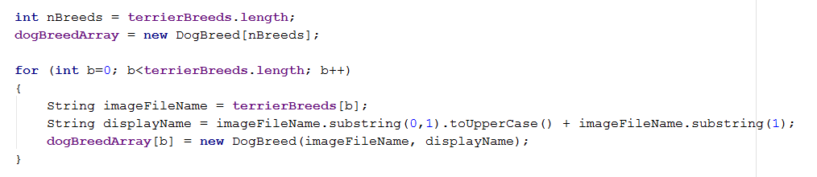
Potentially useful code for part 2
Notes:
Each of the remaining slides shows code from a single method in my solution, from either my TerrierActivity (the sub-child), or the DialogFragment.

Slide 35
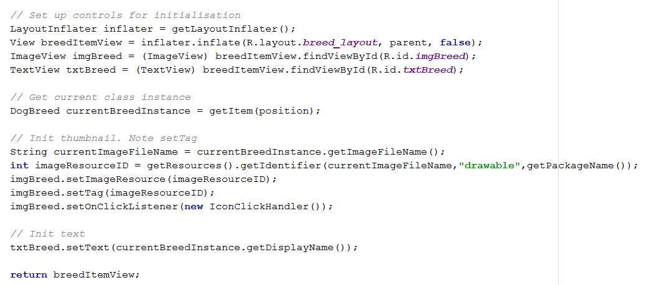
Potentially useful code for part 2

Slide 36
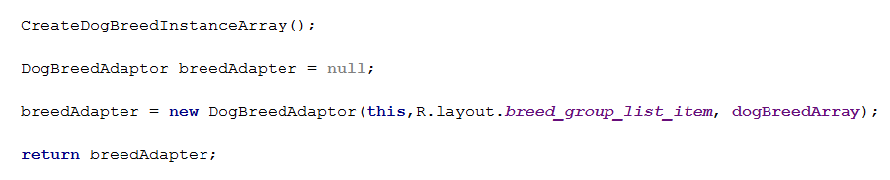
Potentially useful code for part 2

Slide 37
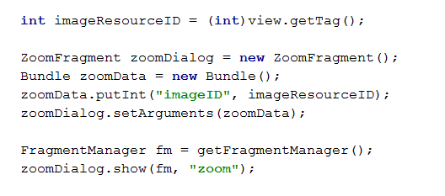
Potentially useful code for part 2

Slide 38
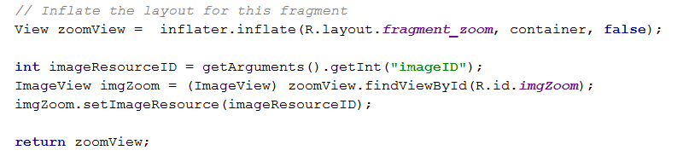
Potentially useful code for part 2

